Slide 1
Two-way ANOVA——Amputee data

Slide 2
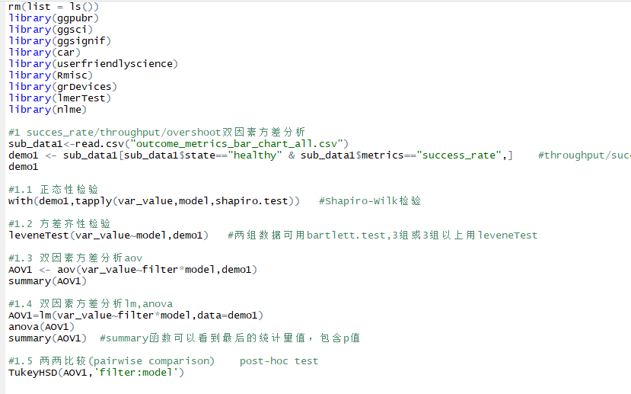
var_value~filter*model

Slide 3
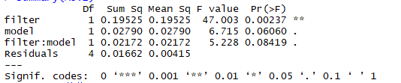
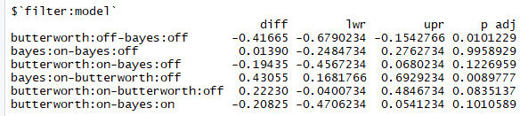
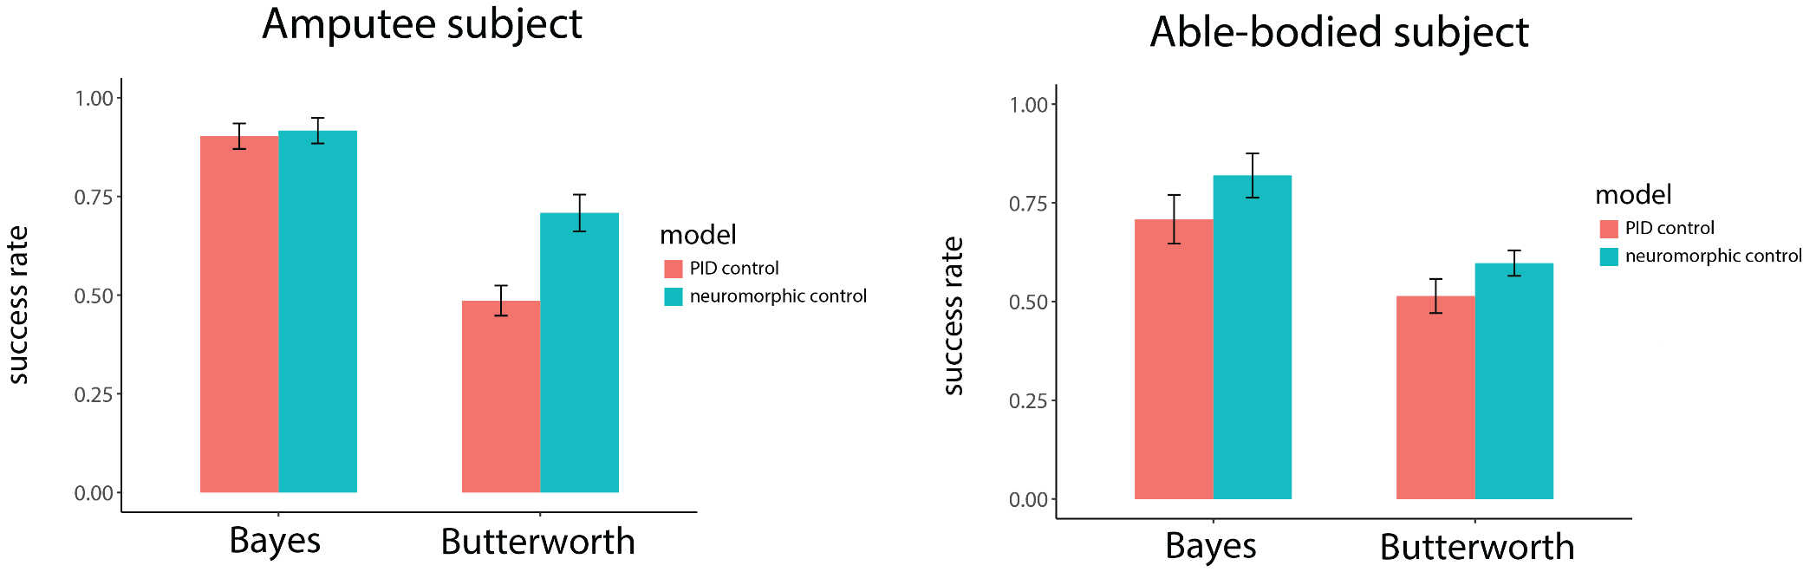
Success rate——Amputee
filter—F(1,4)=47.003, P<0.01
model—(1,4)=6.715, P=0.06060
filter: model —F(1,4)=5.228, P=0.08419

Slide 4
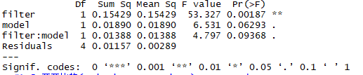
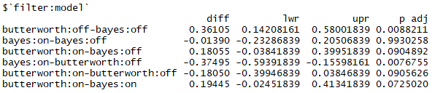
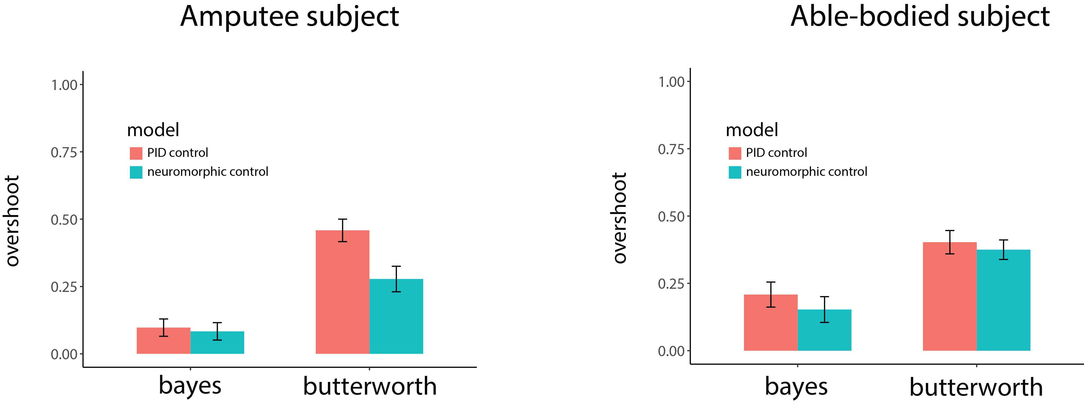
Overshoot ——Amputee
filter—F(1,4)=53.327, P<0.01
model—F(1,4)=6.531, P=0.06293
filter: model —F(1,4)=4.797, P=0.09368
Bayes Butterworth

Slide 5
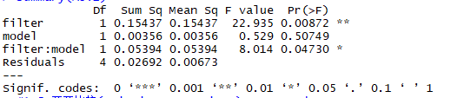
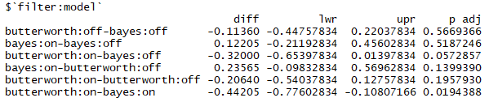
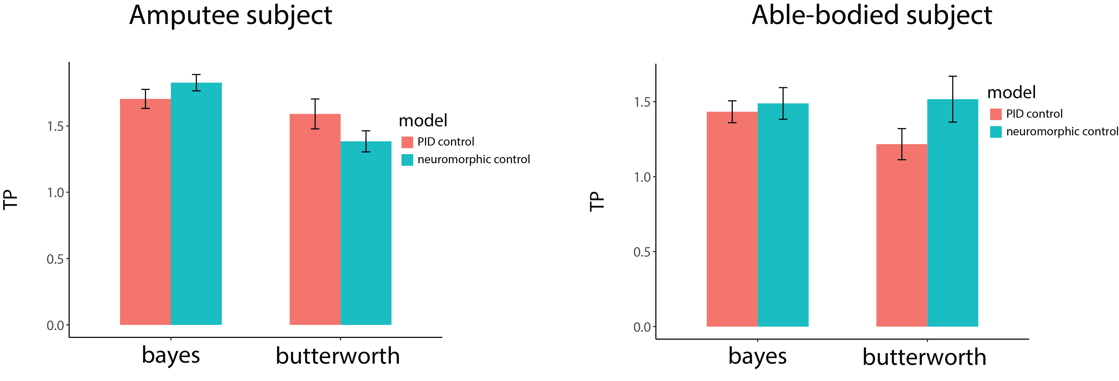
Throughput ——Amputee
filter—F(1,4)=22.935, P<0.01
mode—F(1,4)=0.529, P=0.50749
filter: model —F(1,4)=8.014, P<0.05
Bayes Butterworth

Slide 6
ANOVA——Able-bodied data

Slide 7
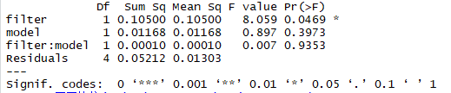
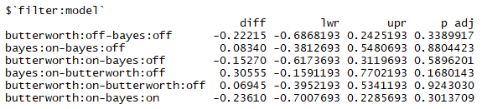
Success rate——able-bodied subject
filter— F(1,4)=8.059, P<0.05
model—F(1,4)=0.897, P=0.3973
filter: model —F(1,4)=0.007, P=0.9353

Slide 8
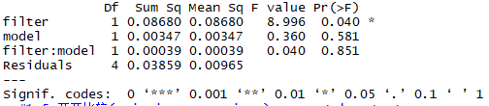
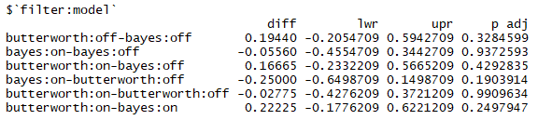
Overshoot ——able-bodied subject
filter—F(1,4)=8.996, P<0.05
model—F(1,4)=0.360, P=0.581
filter: model —F(1,4)=0.040, P=0.851
Bayes Butterworth

Slide 9
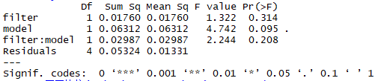
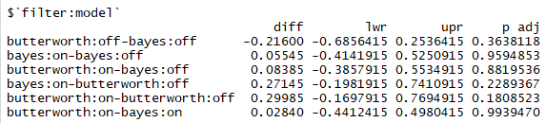
Throughput ——able-bodied subject
filter: F(1,4)=1.322, P=0.314
model: F(1,4)=4.742, P=0.095
filter: model —F(1,4)=2.244, P=0.208
Bayes Butterworth

